Slide 1
Reporting graphs, Tables and other results

Slide 2
Content
Descriptive tests (Mean, Median etc)
Tests of Normality
Tests of difference
Tests of relationship

Slide 3
Reporting results
Descriptive
Frequency Table: Always present percent values with counts where ever possible, for e.g. see able below:
Mean: Provide Standard Deviation or Standard Error; e.g. 24±SD or SE
Median: Provide Standard Deviation or Standard Error; e.g. 24±SD or SE
Percent (%): Always be consistent with decimal places; e.g. 6.15 or 6.2 etc
Household characteristics | Counts (%)
Male | 45 (30)
Female | 55 (70)

Slide 4
Testing whether distribution is normal: Tests of Normality
K-S Test or Kolmogorov –Smirnov test and Shapiro Wilk Test
Homogeneity of Variance or Levene’s test
Q-Q plot or P-P plot
Histogram with normal curve plot

Slide 5
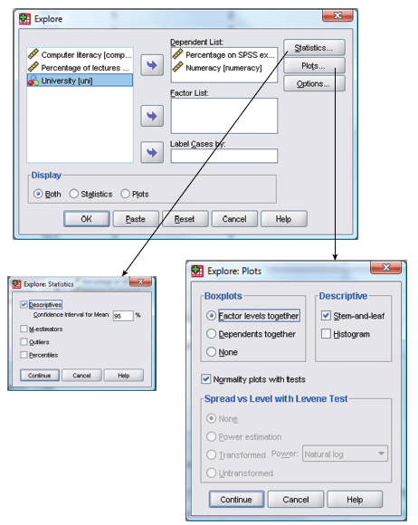
Performing K-S test:

Slide 6

SPSS output: K-S and S-W test
Reporting K-S test

Slide 7
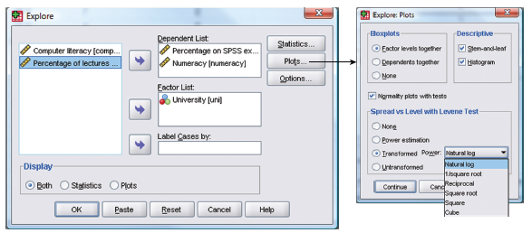
Performing Levene’s test: Checking Normality of data

Slide 8
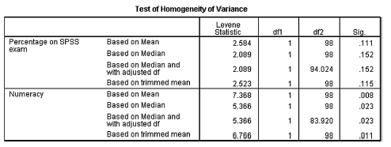

SPSS Output (Levene’s test: Checking Normality of data)
Reporting Levene’s test (Homogeniety of Variance)

Slide 9
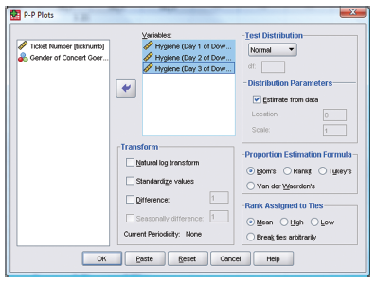
Dialog box for obtaining P-P plots

Slide 10
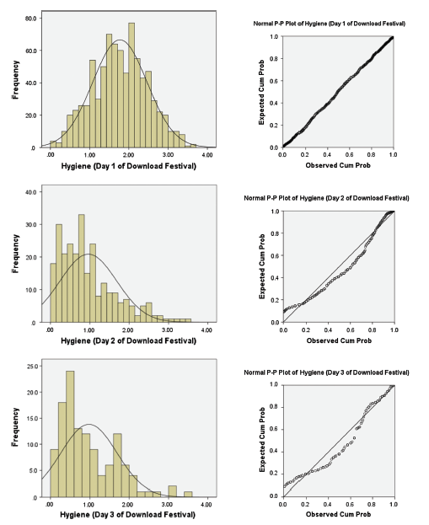
Histogram and P-P plots

Slide 11
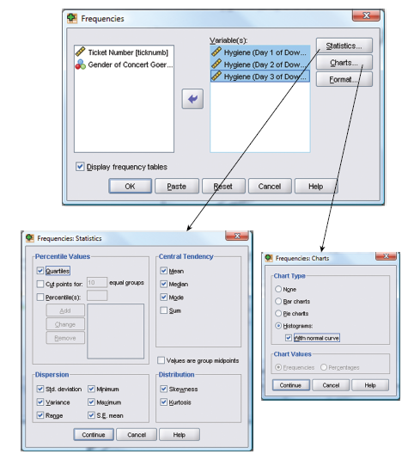
Exploring data: Plotting frequencies

Slide 13
Tests of difference:
If the data are normally distributed (parametric): t-test, ANOVA, ANCOVA etc
If non-parametric: Mann whitney, Wilcoxon, Kruskall Wallis, Chi-square (test for association) etc.
Test of relationship:
Correlation
Regression

Slide 14
T-test using SPSS
Analyze
Compare means
Paired Sample t test
Load the data
OK

Slide 15
SPSS output
On average, participants experienced significantly greater anxiety to real spiders (M = 47:00, SE = 3.18) than to pictures of spiders (M =40.00, SE = 2.68), t(11) = -2.47, p <.05, r = .60.

Slide 16

Analysis of Variance (ANOVA)
(One-way ANOVA – GLM 1)
THREE or MORE SAMPLES

Slide 17
Statistics – Several means – ANOVA (GLM 1)
Analysis of variance (ANOVA) is a versatile statistical test
ANOVA is similar to two sample t-tests and is useful in designed/controlled experiments
ANOVA is used, for THREE or more groups, mainly to analyze the effects of different treatments
ANOVA compares ratio between the systematic variance (experimenter controlled factors) to the unsystematic variance (by random or unknown factors)
The ratio is called F statistics or F ratio
F statistics or F ratio in fact is the ratio between the model and the error

Slide 18
Statistics – Several means – ANOVA (GLM 1)
Any variation within the group is not because of treatment but because of individuals: this is called within-groups variance (unsystematic) or error variance
Difference between total variance and within-groups variance is called the among-groups variance (systematic) of treatment variance
among-groups variance (systematic) OR Model
F ratio =
within-groups variance (unsystematic) OR Residual
Sampling distribution that describes the deference between these variance is called F distribution
F distribution is a probability distribution, depends on df of numerator and denominator

Slide 19
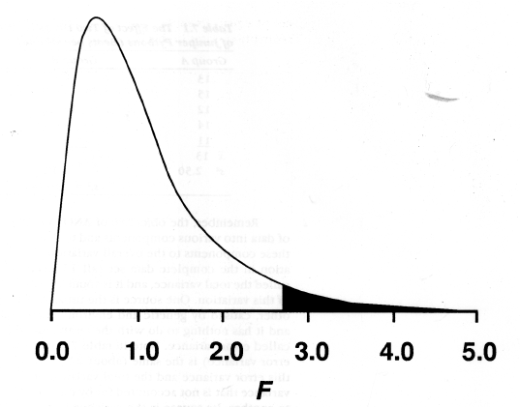
Statistics – Several means – ANOVA (GLM 1)
Shaded portion is α which totals to 0.05
The value that delimits α (0.05) is provided in F distribution table
When treatments have no effect, F value is small, c.1.0, but when treatments have effect F value is large >1.0
If F value is large, p value is <.05, therefore the test is significant, and the null hypothesis is rejected
F ratio tells that there is manipulation effect but does tell about the effect size, so regression model method is useful to calculate the effect size

Slide 20
Statistics – Several means – ANOVA (GLM 1)
Regression model is linear, called GLM (general linear model)
Outcome = model + error
SPSS is more inclined to regression model method and incorporates various types of ANOVA
Various forms of one-way ANOVA exist (one-way because effects of single factor is detected)
One such type of ANOVA is the Fixed-effects ANOVA
This ANOVA is done for experiments with fixed-effects design (completely random design)
Fixed effects because treatments used are chosen by investigator

Slide 21
Statistics – Several means – ANOVA (GLM 1)
ANOVA, in fact, is a special case of regression (and also can be used to predict one variable with others using model)
Assumptions for ANOVA (as in other parametric tests)
Random sample
Continuous variable
Ratio or interval scale
Approximately normally distributed
Error variance are equal (post hoc test) - additional

Slide 22
Statistics – Several means – ANOVA (GLM 1)
Steps to conduct one-way ANOVA in SPSS
1. Load the data
2. Make a new variable called weights & merge the groups
3. Make another variable called groups, and assign groups’ number
4. Make necessary changes in ‘variable view’ window, e.g., scale
5. Analyze
Compare means
One-way ANOVA
Enter ‘weights’ as ‘dependent lists’ & ‘Groups’ as ‘Factor’
Click ‘Post Hoc’ & check LSD or Bonferroni & anyone from equal variance not assumed
In ‘Options’ check ‘Homogeneity …’ & ‘Fixed…’
OK

Slide 23
SPSS output
Reporting: There was significant effect of Viagra on levels of libido, F(2, 12) = 5.12, p<.05,ω = .60

Slide 24
Non-parametric tests

Slide 25
Statistics – Two Populations – Non-parametric Test
Mann-Whitney test in SPSS
1. Load the data
2. Arrange the data in 1 column & give variable name as ‘data’
3. Assign groups for each group of data (i.e., group 1 & Group 2)
4. Analyse
Nonparametric tests
2 independent samples
- move ‘data’ to ‘test variable’ box
- move ‘group’ to ‘grouping variable’
- define the groups as 1 & 2
5. Click OK

Slide 27
Statistics – Two Populations – Non-parametric Test
Wilcoxon Signed-Rank Test in SPSS:
1. Load the data
2. Make necessary changes in Variable View
3. Analyse
Nonparametric tests
2 related samples
- shift both ‘variables’ to ‘test pairs’ box
- check ‘Wilcoxon’ in test type
4. Click OK

Slide 28
Statistics – Several groups– Non-parametric Test
1. Once the normality tests are completed analyze the data in SPSS
2. Analyze
Nonparametric tests
k independent samples
- move ‘data’ to ‘test variable’ box
- move ‘group’ to ‘grouping variable’
- define the groups as min=1 & max=4
- check Kruskal-Wallis & other if any…
3. OK

Slide 29
Statistics – Several groups– Non-parametric Test
In SPSS
Analyze
Nonparametric tests
k related samples
- move ‘all data’ to ‘test variable’ box
- check Friedman
- in Option if you checked Monte, check 95 confidence
Post hoc with Bonferroni correction can be done as in Wilcoxon sign rank test but again with .05 divided by number of pairs to be tested for p & effect size calculated similarly

Slide 30
Tests of relationship: reporting result (Correlation analysis)

Slide 31
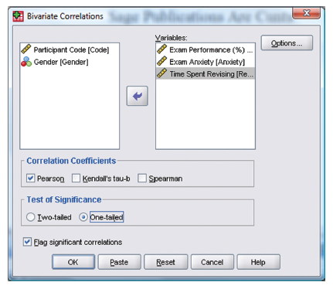
Performing Bivariate correlation

Slide 32
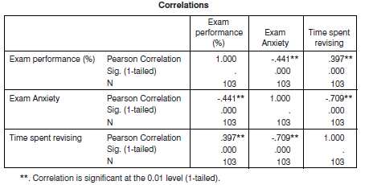
SPSS Out put (Example 1): Correlation analysis

Slide 33
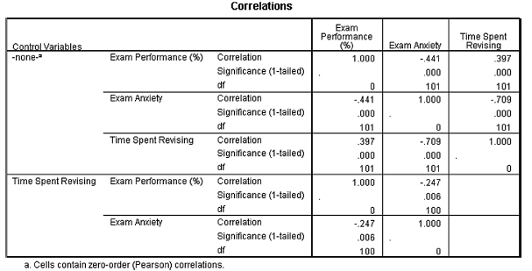
SPSS out put
Reporting: Exam performance was significantly correlated with exam anxiety, r =-.44, and time spent revising, r =.40; the time spent revising was also correlated with exam anxiety, r = -.71 (all p < .05).

